Slide 1
DISSERTATION
Name of the Student:Harshavardhini S.
Name of the Supervisor :Karthic G M
Name of the examiner :Dr. Jayalakshmi N

Slide 2
AI-POWERED PREDICTIVE MODELING OF DIABETIC PATIENT READMISSIONS: AN EXPLAINABLE MACHINE LEARNING APPROACH

Slide 3
INTRODUCTION
Hospital readmissions among diabetic patients are a significant concern due to the chronic and complex nature of diabetes management.
Complications such as hypoglycemia, diabetic ketoacidosis, cardiovascular events, and infections often lead to unplanned readmissions, especially within 30 days of discharge.
These events burden an already overstretched healthcare system and increase the cost of care for patients.
We would need to devise an efficient system which allows us to overcome this issue while at the same time overcoming existing blackbox approaches using conventional ML algorithmic approaches.

Slide 4
INTRODUCTION
Our Proposed Methodology

Slide 5
AIM AND OBJECTIVE
The proposed aim is to Integrate cutting-edge XAI methods like SHAP, LIME, and integrated gradients with Predictive models and demonstrate that this methodology is a step forward in the area of clinical risk prediction for Readmissions with respect to diabetic patients.

Slide 6
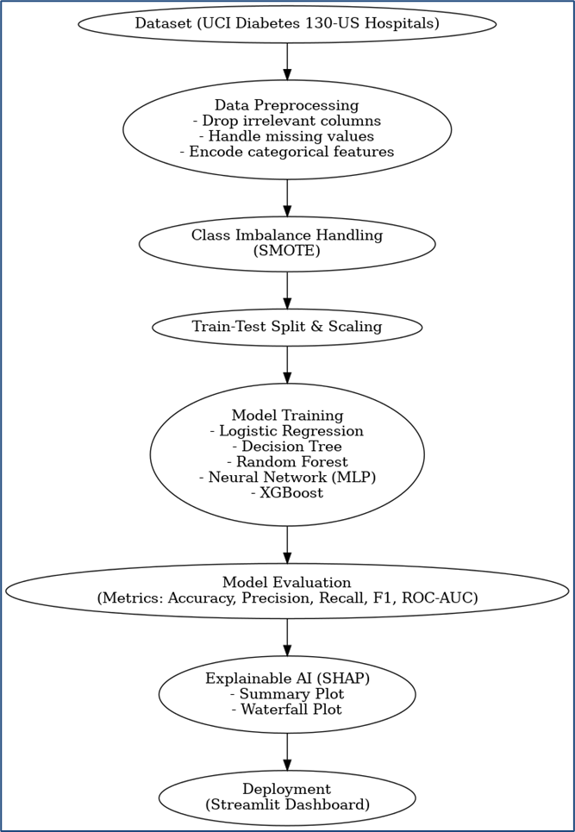
METHODOLOGY

Slide 7
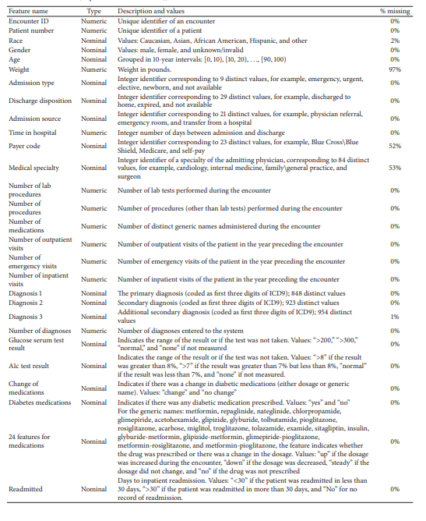
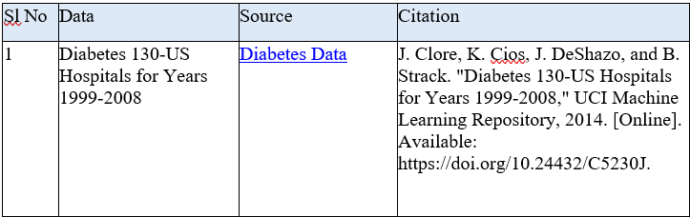
DATASET DETAILS-
The dataset used in this study contains records of over 100,000 hospital admissions for diabetic patients collected over a 10-year period from 130 hospitals across the United States.
Each entry represents a unique inpatient encounter and includes various demographic, clinical, and administrative details associated with the patient and their treatment during the hospital stay

Slide 8
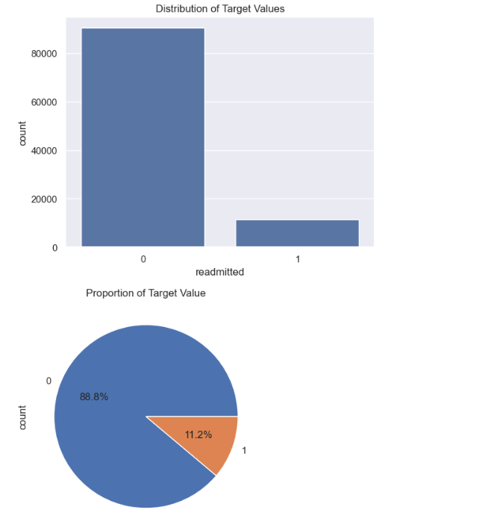
Major findings after EDA (1)
Target Variable considered: Readmitted
0- No
1- Yes
Not readmitted data is substantially higher than that of the Readmitted Data.
Training model with this data as such will lead to a biased model which more inclined towards the non-readmitted cases, increasing chances of false negatives.
Inference: Need to use Dataset Balancing Techniques such as SMOTE.

Slide 9
Major findings after EDA (2)
We make analysis and drop PII data columns and columns which contain too many NaN values.
We transform Target variable from three categories to Binary output :
  <30 as 1 and
  x >30 and No as 0

Slide 10
MODEL TRAINING AND COMPARISON
Model | Accuracy | Precision | Recall | F1 Score | ROC-AUC
Logistic Regression | 0.753 | 0.753 | 0.753 | 0.753 | 0.825
Decision Tree | 0.833 | 0.818 | 0.856 | 0.836 | 0.833
Random Forest | 0.907 | 0.946 | 0.864 | 0.903 | 0.954
Neural Network (MLP) | 0.853 | 0.863 | 0.840 | 0.851 | 0.920
XGBoost | 0.883 | 0.929 | 0.829 | 0.876 | 0.937
Final Takeaway:
Best Model → Random Forest, due to its highest overall scores across all metrics, especially F1 and ROC-AUC.
Close Second → XGBoost, with excellent precision and ROC-AUC, slightly weaker on recall.
Baseline → Logistic Regression, interpretable but less accurate.

Slide 11

MODEL SELECTION
From the analysis made so far, the obvious model which we could select is Random Forest…. But we opted for the second best Model XGBoost- But Why?
Although Random Forest achieved the best predictive performance, we opt for XGBoost as the final model due to its:
  Stronger compatibility with SHAP explainability, computational efficiency, and consistent interpretability of features.
  This makes it better suited for real-world deployment in a clinical decision-support setting, where transparency and trust are essential.

Slide 12
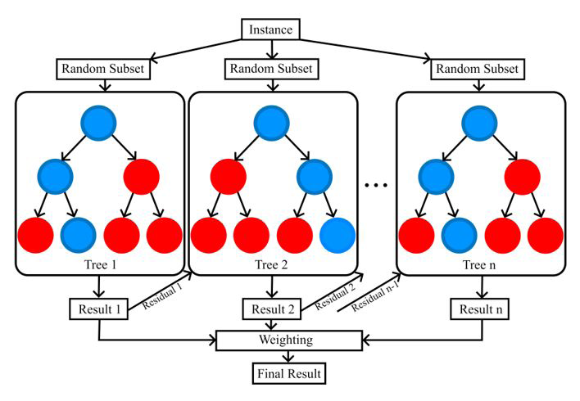
XGBOOST

Slide 13
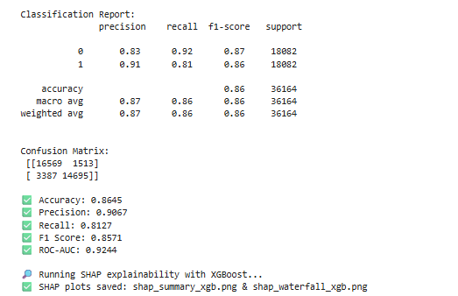
XGBOOST RESULTS

Slide 14
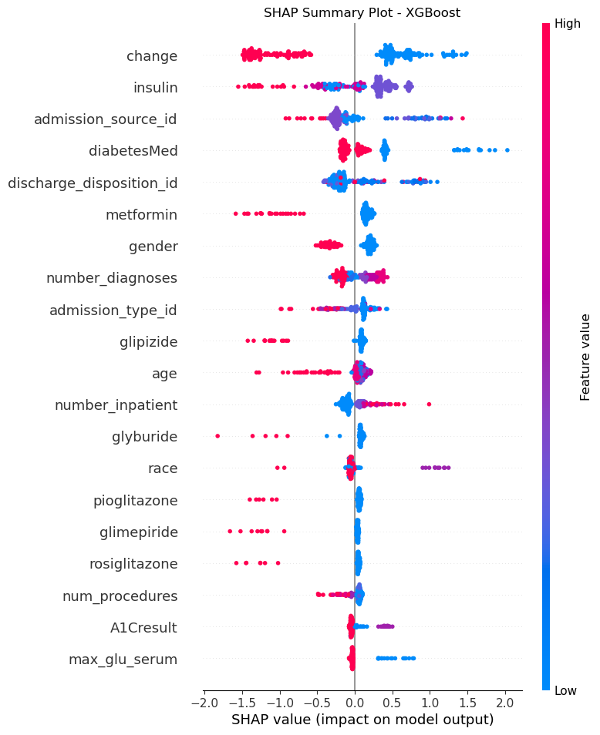
SHAP RESULTS—(1)
SHAP Summary Plot of 200 samples:
The SHAP summary plot ranks features by their contribution to predicting readmission. The most influential factors included medication changes, insulin therapy, and admission source, with high values of these features pushing the model toward predicting readmission.
Discharge disposition, diabetes medications, and the number of diagnoses also played major roles.
Clinical variables such as age, lab results (A1C, glucose serum), and the use of specific diabetes drugs contributed more modestly. The directionality of SHAP values aligns with clinical expectations — for instance, patients with frequent medication changes or multiple inpatient visits are at higher risk of readmission — thereby supporting the model’s interpretability and trustworthiness.

Slide 15
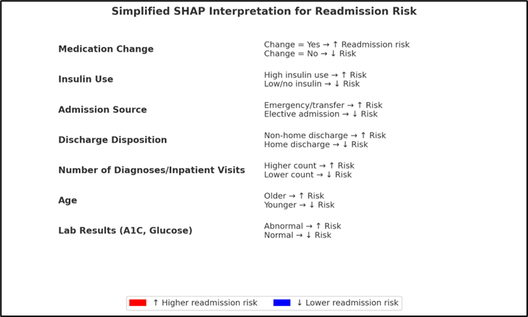
SHAP SUMMARY PLOT SIMPLIFIED INTERPRETATION

Slide 16
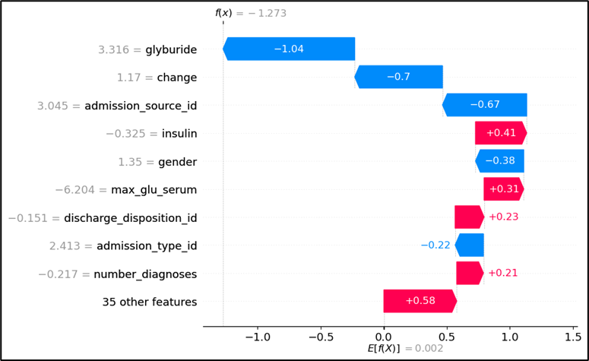
SHAP RESULTS—(2)
SHAP Waterfall Plot of 200 samples:
The SHAP waterfall plot explains individual patient predictions by showing how each feature pushes the risk of readmission up or down.
For this patient, glyburide usage and stable medication significantly reduced the risk, while insulin use and demographic factors slightly increased it. This kind of patient-level interpretability makes XGBoost explainable for clinicians.

Slide 17
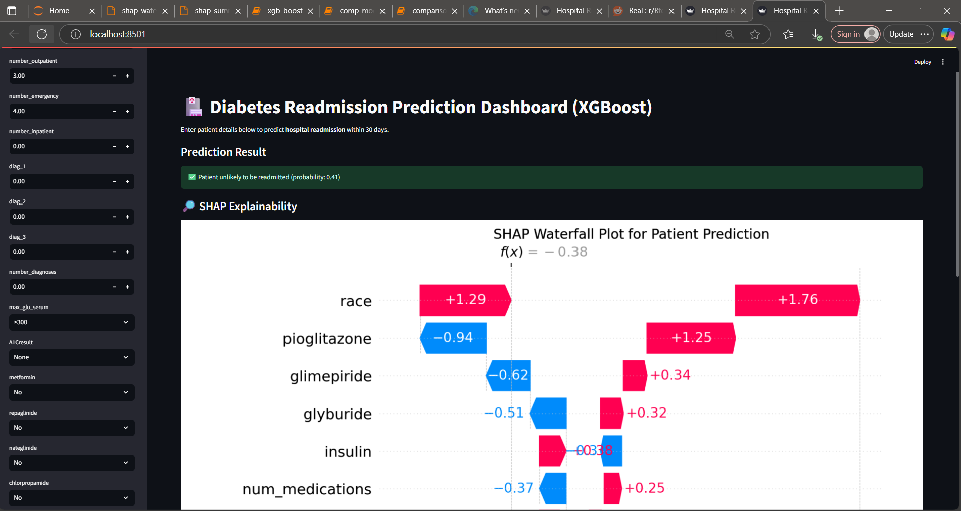
EXPECTED RESULT- DASHBOARD(1)

Slide 18
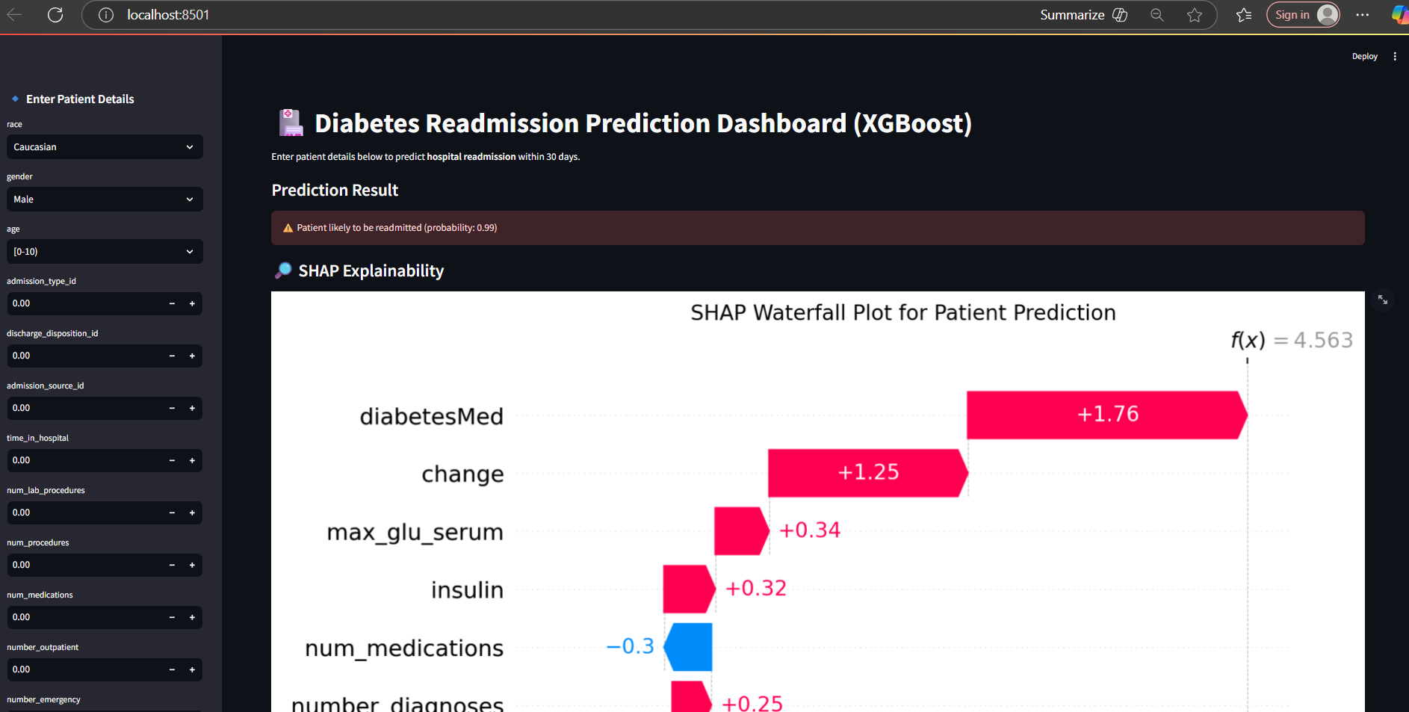
EXPECTED RESULT- DASHBOARD(2)

Slide 19
CONCLUSION
From the dissertation project implemented, we have identified the appropriate dataset which is an Open source dataset from UCI and performed exploratory data analysis.
Based on the data analysis, we could observe that the data set is imbalanced with a majority class being that of the non-readmitted, thus the data set is biased. To overcome this we are making use of SMOTE to handle data imbalances.
This dissertation presented an AI-powered predictive modeling framework for hospital readmission among diabetic patients, with a focus on explainability and clinical usability. The study systematically compared multiple machine learning models — Logistic Regression, Decision Tree, Random Forest, Neural Network (MLP), and XGBoost — after rigorous data preprocessing, SMOTE-based class balancing, and feature scaling.
Dashboard deployed using Streamlit makes the solution scalable, interactive, and usable in real-world hospital settings.
This dissertation demonstrates that AI combined with Explainable AI (XAI) can significantly improve predictive modeling in healthcare while maintaining clinical trust, transparency, and ethical responsibility.

Slide 20
FUTURE WORK
While this dissertation demonstrates the effectiveness of AI-powered hospital readmission prediction with Explainable AI, there remain several avenues for further improvement and exploration.
  Advanced Deep Learning Models: Future studies could investigate the use of Recurrent Neural Networks (RNNs) or Transformer-based architectures to capture temporal patterns in-patient admissions and lab results.
  Federated Learning: Implementing federated learning can enable model training across multiple hospitals without sharing sensitive patient data, thereby enhancing both privacy and generalizability.
  Integration of Additional Data Sources: Incorporating unstructured data such as physician notes, imaging data, and real-time wearable device data may further improve predictive performance.
  Bias and Fairness Analysis: A deeper study on model fairness with respect to race, gender, and socioeconomic factors could help ensure equitable healthcare predictions.
  Clinical Trials and Validation: Deploying the dashboard in a real hospital setting and conducting prospective validation with clinicians will be essential to test real-world usability and impact.
These directions aim to build upon the current work by improving accuracy, interpretability, fairness, and deployment readiness, ultimately supporting better clinical decision-making and reducing avoidable readmissions

Slide 21
THANK YOU!

